Slide 1

Multifleet run your fleet IT SYSTEMS
Presentation created by
Mohammed Khurram

Slide 2
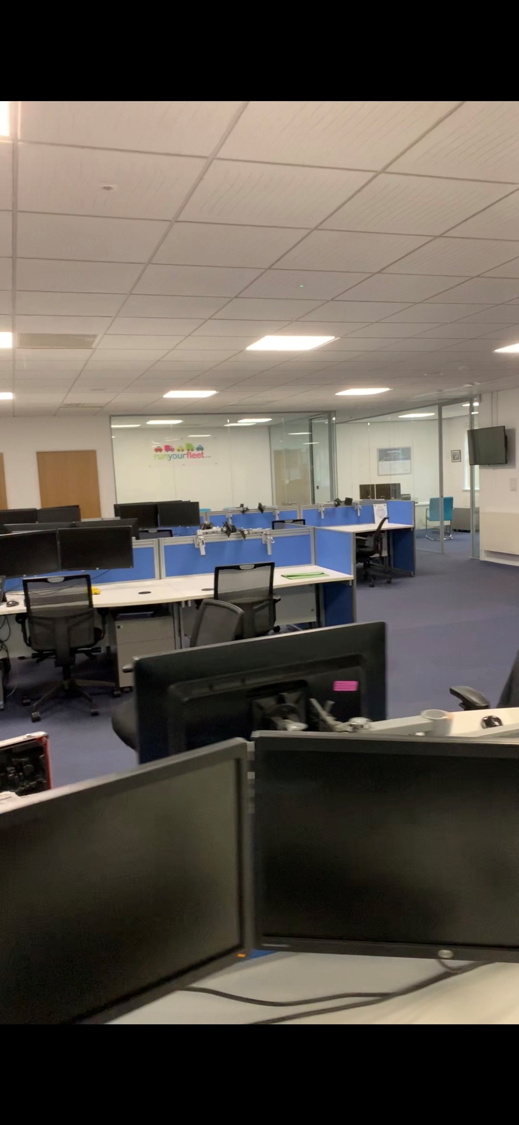
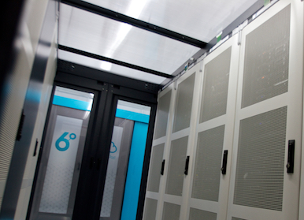

It Infrastructure
6 Degree Data Center
Live Server
Database Server
Website Server
Backup Server
Cisco Firewall
Cisco Router
Multifleet Office Henley In Arden
Cloud Services
OneDrive For Business
SharePoint
Azure
Dynamics 365
Power Platform
Office 365
Amazon Web Service
Domain Server
Test Server
Test Database Server
Network Switches
Phone System
Backup Server
Backup Power

Slide 3
6 Degree Data Center
6 Degree Data Center
Live Server
Database Server
Website Server
Backup Server
Cisco Firewall
Cisco Router
Multifleet.com
United Rental
Customer Dashboard
Cloud Backup
QuickDash
Multifleet Sales
Web Services
Companies House Webservice
DVSA Vehicle Check Web Service
FleetWare
Dynamics 365 CDS API
Fleetware CURD API

Slide 4
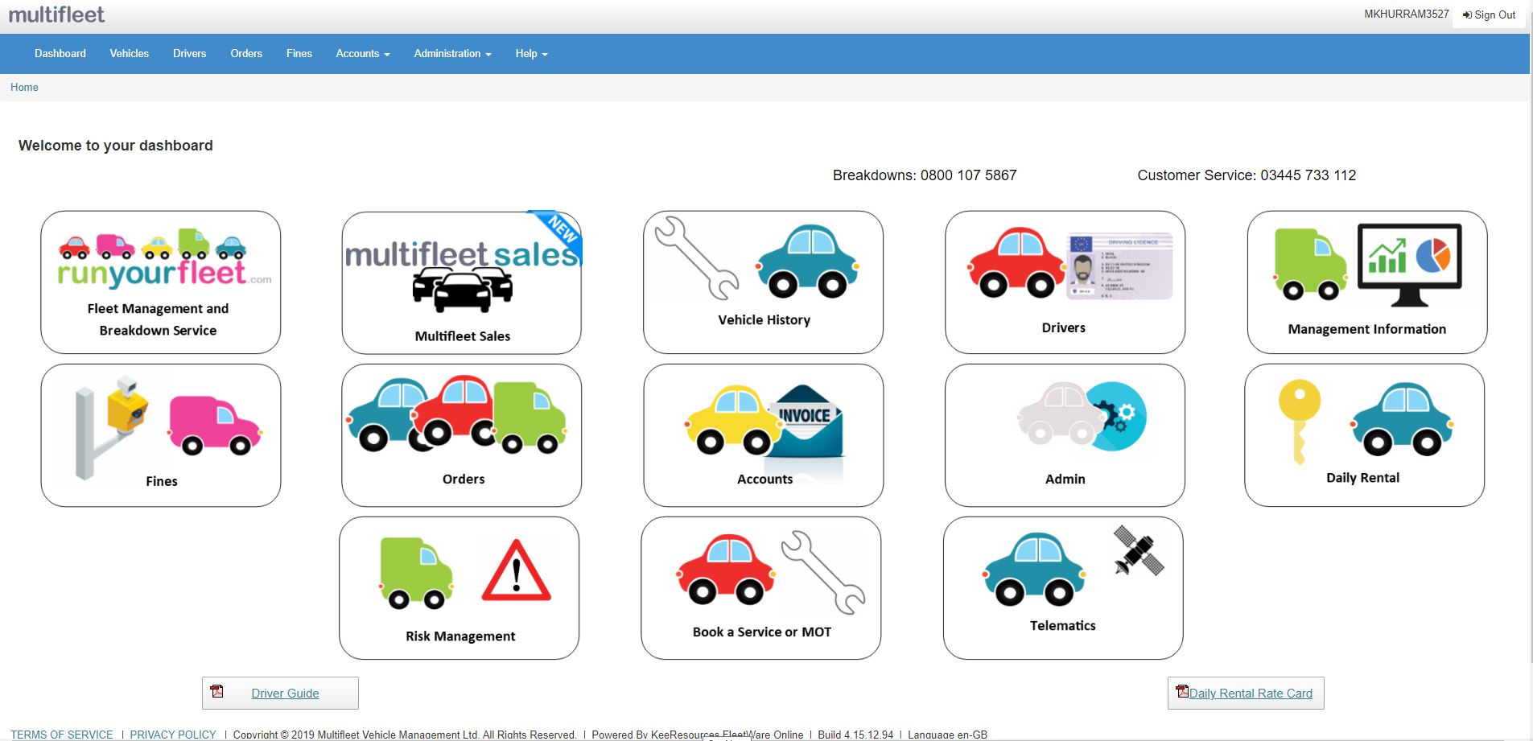
Customer Dashboard
Dashboard Features:
Fleet Management:
Access the sales portal (Multifleet Sales)
Check Vehicle History
View and Add Drivers
View Management Information
View Fines
View Orders
View Invoices
Access Daily Rental Portal (FOD)
Risk Management
Book a Service or MOT
Telematics (Trackm8)

Slide 5
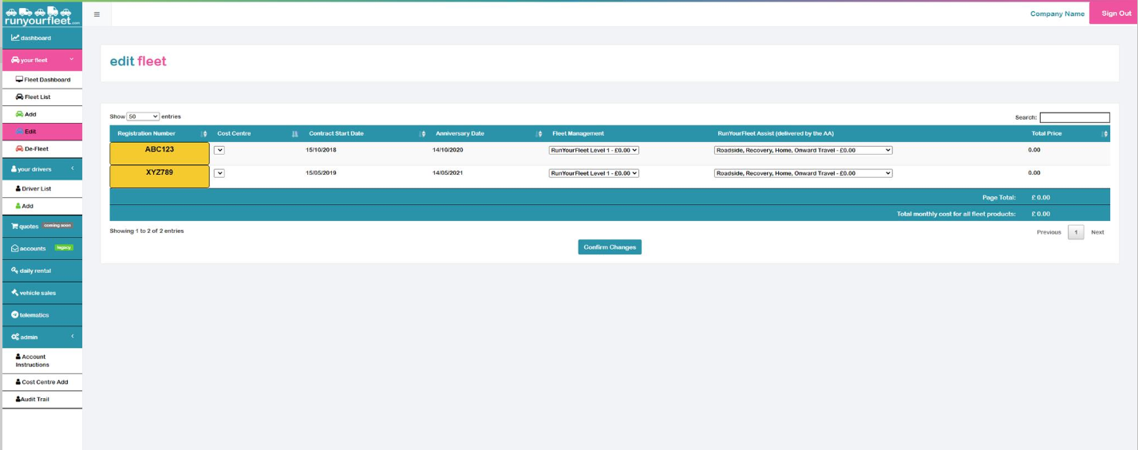
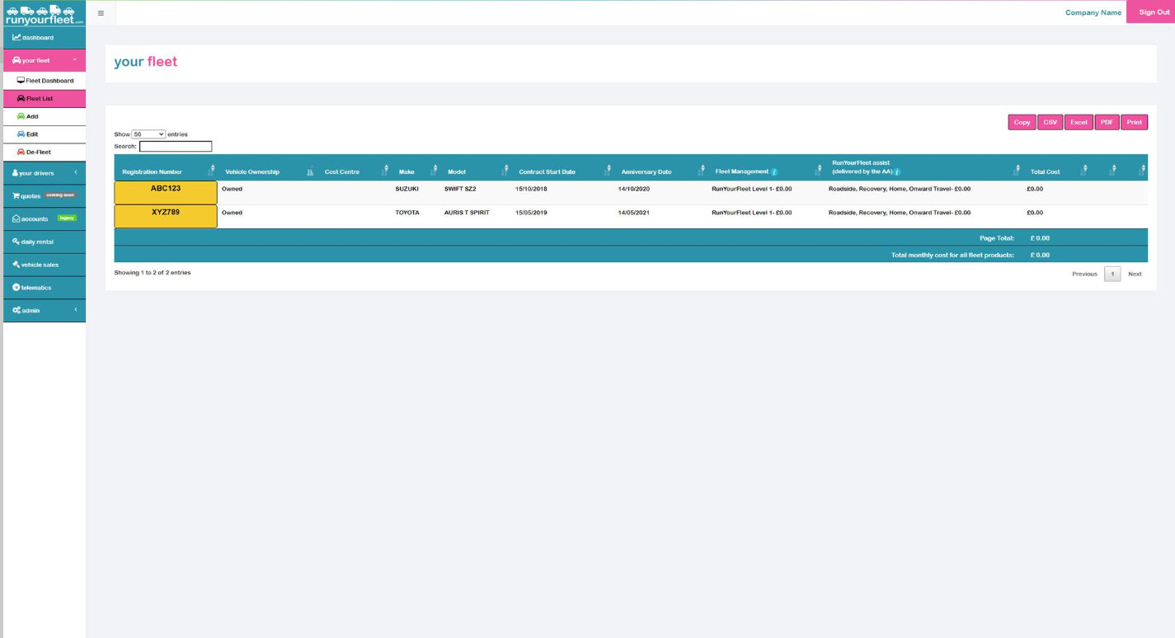
Fleet Management
Customers can add, edit and delete all their vehicles here.
Different level of cover types available.
Discounts available.
Built using C#, MVC, JQuery and SQL.

Slide 6
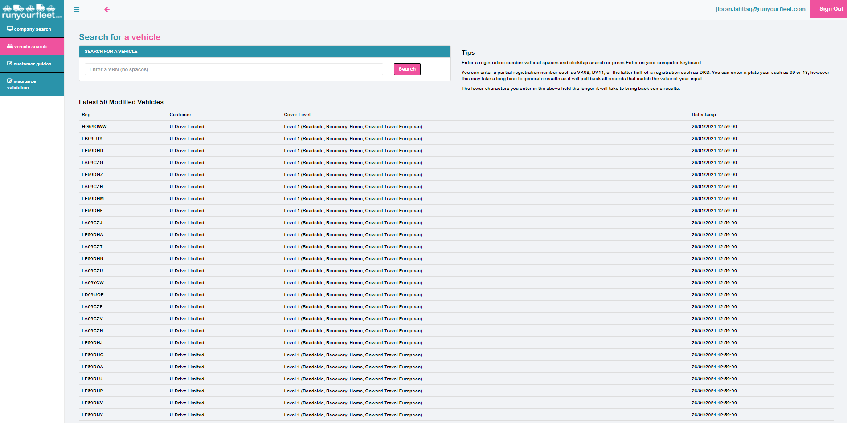
Quickdash
Only used by Internal staff.
Staff can:
Back door login into customer accounts
Lock and unlock customer accounts
View and Edit Customer Information
View and Edit Vehicle information
View Audit Log of a customers account
View errors on customers account
View and change pricing structure
Built using C#, MVC 5.0 and SQL.

Slide 7
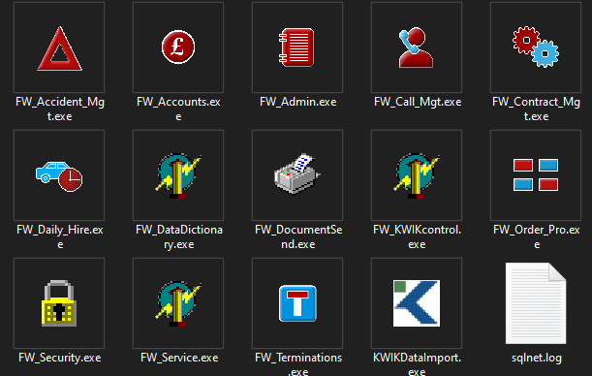

Fleetware
Our Main Back office system powered by Kee Resources
Holds customers information and Vehicle information.
Apart of the Fleet management dashboard and other products and services :
Contract Management
Order Processing
Vehicle Terminations
Accounts and payment
Quotes Browser
Data is stored in Oracle database.

Slide 8
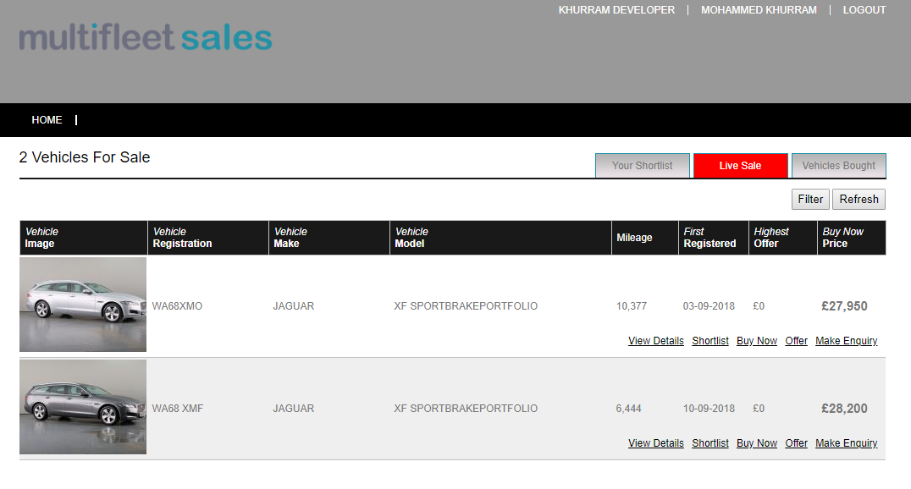
Multifleet sales
Our Vehicle sales portal.
Ex Contract hire vehicles are repaired and then listed on the sales portal.
Recently launched by the IT Team.
Built using C#, ASP.NET and SQL.

Slide 9
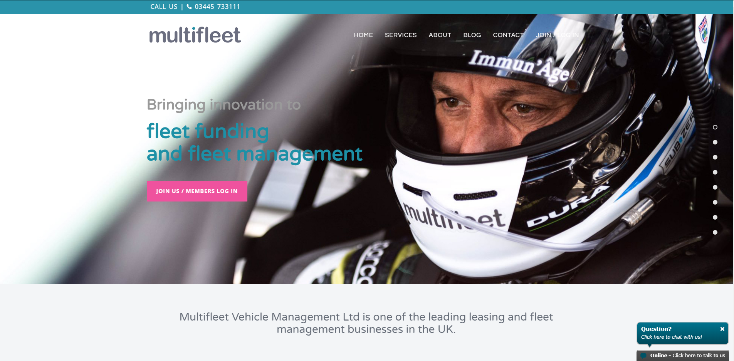
Multifleet.com
One of our main websites to showcase the products we offer.
Built in WordPress using CSS and Java Script.

Slide 10

Runyourfleet.com
One of our main websites to showcase the products we offer.
Built in WordPress using CSS and Java Script.

Slide 11
Multifleet Office Henley In Arden
Multifleet Office
Network
Phone Systems
Backup Power
Avaya Switch
Test Server
Test Database Server
RunYourFleet Domain
Azure AD
Test FleetWare
Test Customer Dashboard
Test QuickDash
Customer and Guest Wi-Fi
LAN Failover
Call-Stream Line
Staff LAN Network
Staff Wi-Fi
Staff IP Phones
Lease Line
POE Switch
All PC
All Phones
Back up of all servers
UPS for all network devices and servers
Servers
Physical Servers
Virtual Server
Time Server
Time for Server and Phones
Backup Servers
Henley Host 1
Domain
Henley Host 2
Failover
Lease Line
EE Broadband

Slide 12
Cloud Services
Cloud Services
One Drive For Business
Azure
Dynamics 365
Power Platform
Office 365
SharePoint
Amazon Web Service
Reporting
Staff Desktop and Documents
Share Drives
Azure AD
Power Bi Reports
Power Apps
IT Ticketing System
Azure Dev Ops
MS Office
Mail Server
MS Teams
Crystal Reports
Power Bi Reports
Single Sign on

Slide 13
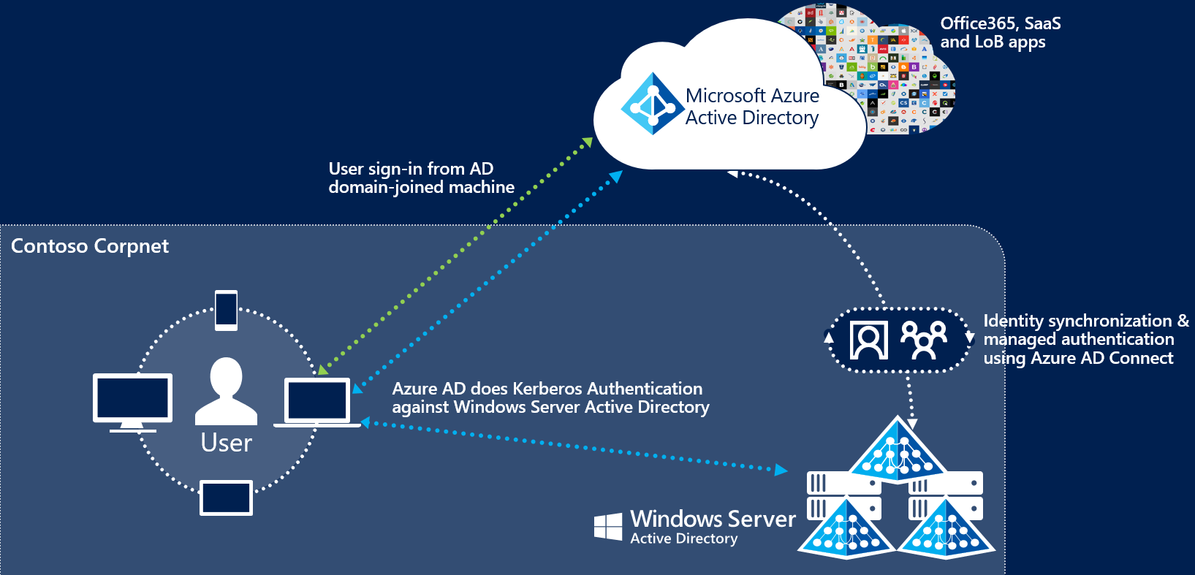
Single Sign on

Slide 14
It Equipment
Hardware
Servers
Mobile Phones
Phones
Multimedia
Tvs
Projector
Hp and Dell Servers
Desktops
Switches & Routers
Dell PCs
Laptops
Dell Laptops
Tp Link
Cisco
Billion
Avaya
Avaya IP Phone
IPhones

Slide 15
It Software
Software
Servers
Windows Sever 2012 R2
Linux Centos
Windows 10
MS Office 365
Visual Studio
Adobe Products
Desktops and Laptops
Crystal Report
WordPress
Power Bi
OneNote
MS Teams

